Slide 1
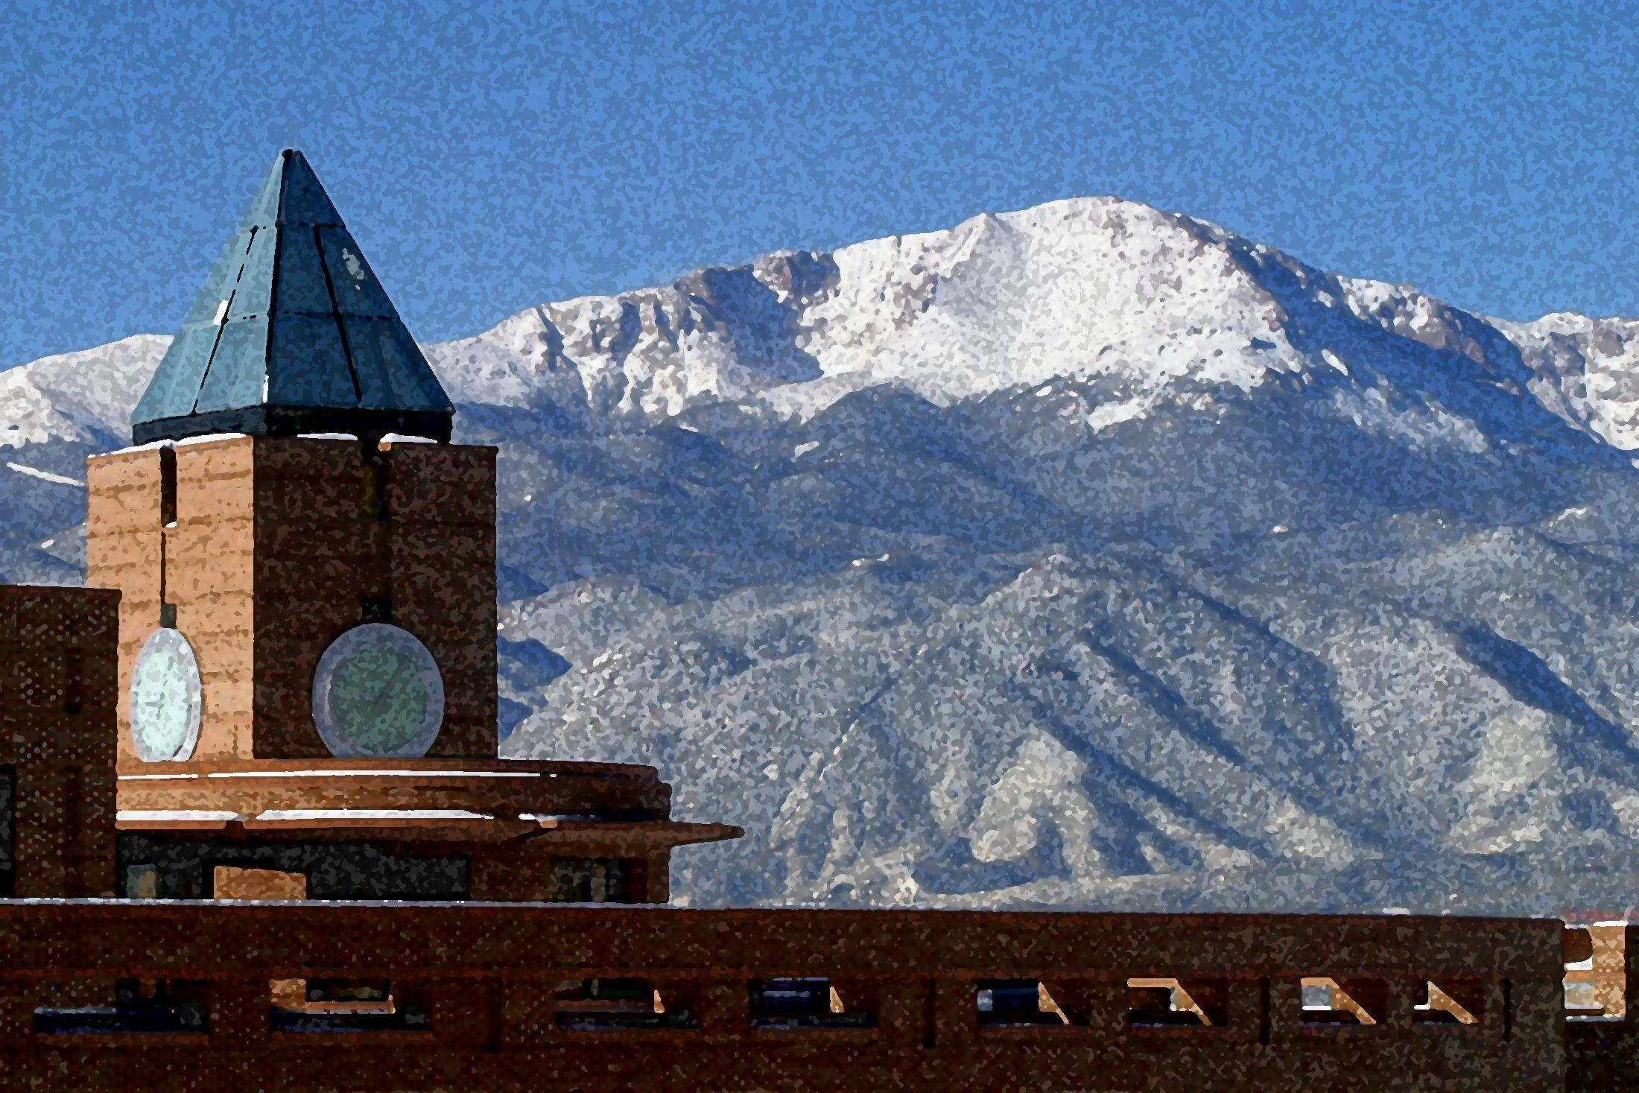
An Inquiry into Math Teachers’ Circle: Findings from Two Year-long Cohorts
Presented By
David H. Khaliqi, M.A.
Center for STEM Education
Also, Peter D. Marle and Lisa L. Decker
Presented by
Peter D. Marle, B.A.
Math Teachers’ Circle

Slide 2
Overview of Math Teachers’ Circle
Initiated by the American Institute of Mathematics in 2006
Aimed at building a community of mathematics teachers who enjoy math
Serves to reform teachers’ pedagogy
Can also serve to to increase teaching self-efficacy
Math Teachers’ Circle as a Professional Development program
May help to counter the diminutive US math scores noted over the past few decades
Current Math Teachers’ Circles
44 MTCs in 29 states
20 more MTCs being established, totaling 35 states and territories
Math Teachers’ Circle

Slide 3
Overview of Math Teachers’ Circle
Current Research investigating MTCs impact on Educators
White (2011), White and Donaldson (2011)
Mathematical Knowledge for Teaching (MKT)
Teachers who completed MTC showed increased MKT from pre-test scores
MKT is positively correlated with problem-solving abilities in teachers
MKT increases occur indirectly
Other influences from participation in MTCs
Gains in math content knowledge and problem-solving skills
Increased attitudes toward mathematics
Increased reformed-based classroom activities
MTC programs are increasing,
providing seemingly myriad opportunities for research
Math Teachers’ Circle

Slide 4
Research Opportunities with MTC
Research has shown that increasing teaching self-efficacy positively influences student outcomes, such as:
Achievement (Yoon, Duncan, Lee, & Shapley, 2008)
Motivation (Stipek et al., 1998)
Attitudes (Madsen & Lanier, 1992)
Student self-efficacy, interest, and greater student perceptions of importance in what they were being taught (Tschannen-Moran, Woolfolk Hoy, & Hoy, 1998)
Teaching Self-Efficacy
Math Teachers’ Circle

Slide 5
Research Opportunities with MTC
A teacher’s
(1) analysis of the teaching task and its context and
(2) assessment of personal teaching competence
directly influence their teaching efficacy (Tschannen-Moran et al., 1998)
Analysis of the teaching task: “what will be required of them in the anticipated teaching situation … [including] such factors as the students' abilities and motivation, appropriate instructional strategies, managerial issues, the availability and quality of instructional materials, access to technology, and the physical conditions of the teaching space” (p. 231)
Assessment of personal teaching competence: “the individual's comparative judgment of whether his or her current abilities and strategies are adequate for the teaching task in question” (p. 233)
Pedagogical Preparedness
Teachers’ Personal Teaching Competence
Math Teachers’ Circle

Slide 6
Research Opportunities with MTC
Bandura’s Social Learning Theory (1977)
Personal Self-Efficacy
“A judgment of one’s ability to organize and execute given types of performances” (p. 21)
Encompasses both of Tschannen-Moran et al. (1998) influences of teaching efficacy
Outcome Expectancy
“A judgment of the likely consequence such performances [referring to personal self-efficacy definition] will produce” (p. 21)
Teachers who have a greater perception of control in their students’ learning along with high teaching efficacy, should “persist longer, provide a greater academic focus in the classroom, and exhibit different types of feedback than teachers who have lower expectations concerning their ability to influence student learning” (Gibson & Dembo, 1984; p. 570)
Math Teachers’ Circle

Slide 7
Hypotheses
Increases would occur following participation in MTC
Self-efficacy in providing guidance in mathematics
Self-efficacy in their preparedness for teaching mathematics (i.e., pedagogical preparedness)
Reform-based methods (i.e., investigative culture)
Reform-based practices
Feelings of freedom from standards-based teaching
Personal mathematics teaching efficacy, and
Outcome expectancies of their students
Decreases would occur following participation in MTC
Traditional teaching practices were hypothesized to decrease
Observation and interview data would suggest
Changes toward reform-based pedagogy and
Deeper understandings of mathematical concepts
Math Teachers’ Circle

Slide 8
Method
Participants (spanning three cohorts)
Due to low sample size for within subjects analyses, pre/post data were assessed using independent samples t tests
No differences (one-way ANOVA; p > .05) occurred among cohorts for:
Age, grade-level taught, or total years teaching math
Table 1 Participant Demographic Data
 |  | Full Dataset | Survey Only | Observation Only | Interview Only
Pre | N (Male:Female) | 52 (10:42) | 52 (10:42) 29 (5:24) | 34 (7:27) 23 (4:19) | 34 (7:27) 23 (4:19)
Post
Pre | Age Range (years; M, SD) | 23 – 62 (40, 11) | 23 – 62 (40, 11) 24 – 55 (39, 11) | 23 – 62 (41, 11) 25 – 54 (40, 10) | 23 – 62 (41, 11) 25 – 54 (40, 10)
Post
Pre | Grade Level Range (Median) | 2 – 12 (7.5) | 2 – 12 (7.5) 5 – 10 (7.5) | 2 – 12 (7.5) 5 – 10 (7.5) | 2 – 12 (7.5) 5 – 10 (7.5)
Post
Pre | Total Years Teaching Math Range (M, SD) | 1 – 33 (11, 8) | 1 – 33 (11, 8) 1 – 29 (11, 8) | 1 – 33 (11, 9) 1 – 29 (12, 8) | 1 – 33 (11, 9) 1 – 29 (12, 8)
Post
Note. Eleven teachers did not complete the MTC program; their data is not included in this presentation.
Math Teachers’ Circle

Slide 9
Method
Materials and Procedure
Data were collected with university IRB approval
Participants first completed:
Informed consent form
Demographic information sheet
Pre-survey – aggregated from:
Items from the Local Systemic Change through Teacher Enhancement-Math Questionnaire (LSC; Horizon, 2000)
Mathematics Teaching Efficacy Beliefs Instrument
(MTEBI; Enochs, Smith, & Huinker, 2000)
Pre/post observations and interviews were collected starting with last year’s cohort
Reformed Teaching Observation Protocol (RTOP; Piburn & Sawada, 2000)
Teacher Beliefs Interview (TBI; see Luft & Roehrig, 2007)
Math Teachers’ Circle

Slide 10
Method
Materials and Procedure
Upon completion, teachers in the MTC program received a stipend ranging from $400 to $1,500 (depending on availability of funds /cohort)
Participants were given the opportunity to gain 2 hr of graduate-level credits
Program contained approximately 38 hr of professional development
Teachers first participated in a week-long immersion academy
Then attended six evening sessions throughout the school-year
Math Teachers’ Circle

Slide 11
Method
MTC curricula
Immersion Week
Immersive, hands-on activities designed to invoke inquiry and discussion among the teachers
Held out of town to enable participants to fully engage in the MTC program
Upon arrival, participants were briefed on the week’s activities
Briefing was followed by participants’ engagement in activities throughout the week
The open-inquiry activities were designed to
challenge higher-order thinking skills (e.g., problem-solving)
promote cohesion among the teachers within the cohort
Teachers worked in varied groups ranging in size from two to four
Math Teachers’ Circle

Slide 12
Method
MTC curricula
Evening Sessions
Participant teachers attended six evening sessions, each lasting 2.5 hours
Following a dinner, participants first listened to a guest speaker for 1 hour
Each guest speaker presented a problem in order for participants to accomplish several inquiry-based activities in groups
Discussion followed the activity
Purpose of the discussion was to
personalize each problem for the groups
discuss possible extensions of the problem(s)
Each teacher was also required to develop, implement, and discuss a lesson
Math Teachers’ Circle

Slide 13
Results
Survey Data
Table 1 Self-Reported Pre/Post Results
Survey; Hypothesis - Composite | Scale Range | Pre M (SD) | Post M (SD) | t (p)
LSC-Math; 1 - Prepared to Provide Guidance | 1 - 4 | 2.78 (0.60) | 2.84 (0.70) | -0.52 (.610)
LSC-Math; 2 - Pedagogical Preparedness | 1 - 4 | 2.70 (0.65) | 3.20 (0.67) | -3.82 (.001)
LSC-Math; 3 - Investigative Culture | 1 - 5 | 3.99 (0.53) | 4.16 (0.60) | -2.94 (.007)
LSC-Math; 4 - Investigative Practices | 1 - 5 | 2.12 (0.45) | 2.31 (0.55) | -2.15 (.041)
LSC-Math; 5 - Standards-Based Teaching | 1 - 5 | 3.81 (0.81) | 3.83 (0.97) | -0.13 (.896)
MTEBI; 6 - Personal MT Efficacy | 1 - 5 | 4.23 (0.33) | 4.41 (0.36) | -2.48 (.020)
MTEBI; 7 - MT Outcome Expectancy | 1 - 5 | 3.60 (0.60) | 3.65 (0.49) | -0.70 (.488)
LSC-Math; 8 - Traditional Practices | 1 - 5 | 3.80 (0.71) | 3.84 (0.55) | -0.38 (.705)
Note. MT = Mathematics Teaching. df = 26.
n.s. not significant
n.s. not significant; * hypothesized to decrease
Math Teachers’ Circle

Slide 14
Results
Interview Data
Table 2 Observation and Interview Results
Survey; Hypothesis - Composite | Scale Range | Pre M (SD) | Post M (SD) | t (p)
TBI; 9 - Reform-Based Practices | 1 - 5 | 2.36 (0.80) | 2.96 (0.91) | -2.69 (***)
Note. df = 26. *** p < .001
p < .001
Math Teachers’ Circle

Slide 15
Results
Observation Data
Table 3 Observation and Interview Results
Survey; Hypothesis - Composite | Scale Range | Pre M (SD) | Post M (SD) | t (p)
RTOP; 9 - Inquiry Orientation | 0 - 4 | 1.64 (0.73) | 2.65 (0.99) | -4.61 (***)
RTOP; 10 - Content Propositional Knowledge | 0 - 4 | 1.80 (0.78) | 2.57 (1.04) | -3.29 (***)
Note. df = 26. *** p < .001
p < .001
Math Teachers’ Circle

Slide 16
Discussion
Findings of the Current Study
Results suggest teachers
Felt more prepared to teach inquiry-based lessons
Reported increased reformed-based culture and practices
Had more self-efficacy for teaching mathematics after MTC participation
Observation/interview data suggest the teachers
Used more inquiry-based methods in their classrooms
Showed increases in their understanding of mathematical concepts
In contrast, teachers’ self-reported data indicated
No differences in their freedom to integrate MTC material into their curricula (standards-based teaching)
No changes in their traditional teaching practices or preparedness to provide guidance
No changes in their outcome expectancy
Math Teachers’ Circle

Slide 17
Discussion
Findings of the Current Study
Even though the teachers self-reported as maintaining traditional curricula
Interview and observation data suggest otherwise
Self-reported data regarding investigative culture and practices also suggest otherwise
Possible explanation:
The teachers may feel compelled to maintain the standards enforced by their school, district, or state. In doing so, they may feel held back and teach traditionally-planned lessons. However, the teachers may not realize that inquiry-based pedagogy may be innately articulated in their instruction, explaining why the observation data did suggest less traditional instruction following MTC
Even though teachers reported changes in the personal self-efficacy for teaching, no changes in their Outcome Expectancy were reported
Math Teachers’ Circle

Slide 18
Discussion
Limitations of the Study
Sample size
Had to analyze cohort pre/post data as independent, albeit the repeated measures design
Possible ceiling effect for Personal Mathematics Teaching Efficacy
Pre to post data still showed significant increase
Generalizability
Current study reported on one MTC
Data should not be used to generalize to other MTCs
Math Teachers’ Circle

Slide 19
Discussion
Future Direction of the MTC
More research investigating MTCs is necessary
Further research might focus on determining how to incorporate methods learned in MTC into standards-based curricula
Future research should also investigate student outcomes
Math Teachers’ Circle

Slide 20
Discussion
Implications
Past research of other MTC programs has been shown to
Increase Mathematical Knowledge for Teaching and problem-solving skills
May suggest that the participating teachers are better equipped to guide their students in mathematical activities
Promote better attitudes toward math
Promote more reform-based activities in class
Results of the current study corroborate
The finding that MTC increases understanding of mathematical concepts (i.e., Mathematical Knowledge for Teaching)
The increased use of reform-based practices in the classroom
Math Teachers’ Circle

Slide 21
Discussion
Implications
Results of the current study also suggest
Personal Mathematics Teaching Efficacy increased following participation in MTC
However, Mathematics Teaching Outcome Expectancy did not increase
As outcome expectancy is linked to outside factors (e.g., family, home environment, etc.) this was not a surprise, but may be worth investigating more
MTCs can be a valuable tool for math teachers, providing them with a community of peers who enjoy math
MTCs can provide other professional development, as well (e.g., math knowledge, self-efficacy, attitudes)
Reform-based activities learned in MTC can be incorporated into classrooms
The increased attitudes, self-efficacy, and math knowledge teachers show following MTC may also positively impact students
Math Teachers’ Circle

Slide 22
Thank you!
Questions?
Math Teachers’ Circle

Slide 23
References
Bandura, A. (1977). Self-efficacy: Toward a unifying theory of behavioral change. Psychological Review, 84, 191-215.
Enochs, L.G., Smith, P.L. & Huinker, D. (2000). Establishing factorial validity of the mathematics teaching efficacy beliefs instrument. School Science and Mathematics, 100, 194-202.
Gibson, S., & Dembo, M. H. (1984). Teacher efficacy: A construct validation. Journal of Educational Psychology, 76, 569-582.
Horizon Research, Inc. (2000). Local systemic change through teacher enhancement mathematics 6-12 teacher questionnaire. Available from http://www.horizon-research.com/
Luft, J. A., & Roehrig, G. H. (2007). Capturing science teachers’ epistemological beliefs: The development of the Teachers Beliefs Interview. Electronic Journal of Science Education, 11, 38-63.
Madsen, A. L., & Lanier, P. E. (1992). Improving mathematics instruction through the role of the support teacher. East Lansing, MI: The Institute for Research on Teaching, College of Education, Michigan State University.
Piburn, M., & Sawada, D. (2000). Reformed Teaching Observation Protocol (RTOP): Reference manual (ACEPT Technical Report IN00-3). Retrieved from Arizona State University website: http://www.public.asu.edu/~anton1/AssessArticles/Assessments/Chemistry%20Assessments/RTOP%20Reference%20Manual.pdf
Stipek, D. J., Salmon, J. M., Givvin, K. B., Kazemi, E., Saxe G. & MacGyvers, V. L. (1998). The value (and convergence) of practices suggested by motivation research and promoted by mathematics education reformers. Journal for Research in Mathematics Education, 29, 465–488.
Tschannen-Moran, M., Woolfolk Hoy, A. W., & Hoy, W. K. (1998). Teacher efficacy: Its meaning and measure. Review of Educational Research, 68, 202-248.
White, D. (2011). Math Teachers' Circles - Impacting teachers' Mathematical Knowledge for Teaching. Paper presented at the MAA Session on Fostering, Supporting, and Propagating Math Circles for Students and Teachers, I, Joint Mathematics Meetings, New Orleans, LA.
Yoon, K. S., Duncan, T., Lee, S. & Shapley, K. (2008, March). The effects of teachers’ professional development on student achievement: Findings from a systematic review of evidence. Paper presented at the annual meeting of the American Educational Research Association, New York.
Math Teachers’ Circle

